Slide 1
Food Sales Insights and Predictions
Kim Hixson

Slide 2
Data Origin, Analysis, and Modeling
Dataset was obtained from food sales data that included data on Item Weight, Fat Content, Visibility, Type, Manufacturer Retail Price (MRP), Outlet Establishment Year, Outlet Size, Outlet Location, Outlet Type, and Item Outlet Sales.
The first goal of this analysis was to find trends or correlations between MRP and other categories.
The second goal was to determine if a linear regression or simple decision tree regression model was best to model the data for future sales predictions

Slide 3
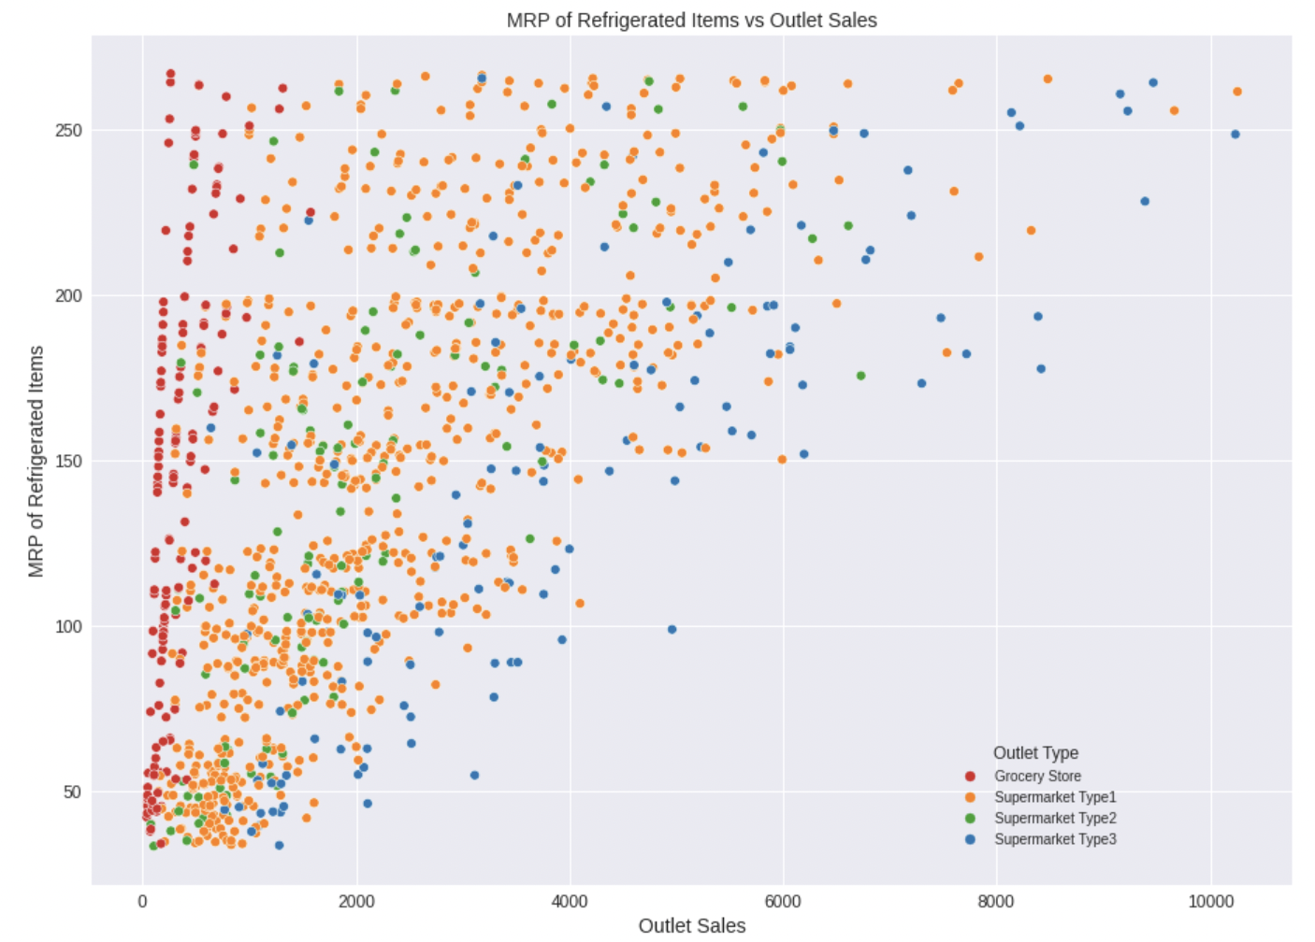
MRP of Refrigerated Items Versus Outlet Type
The chart shows that Supermarkets of Type1 sale the most refrigerated items compared to other outlet types.
There is a positive correlation between the MRP of refrigerated items and overall outlet sales
Grocery Store MRP of Refrigerated Items have the highest correlation to overall outlet sales

Slide 4
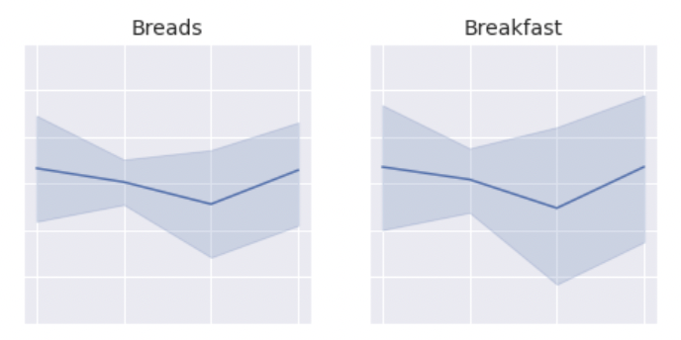

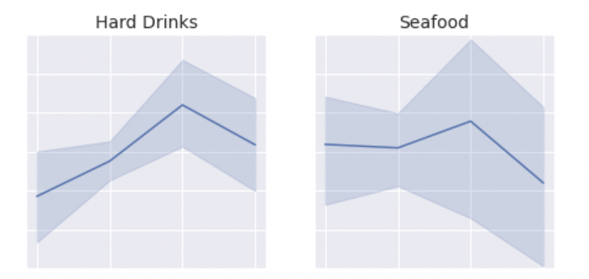
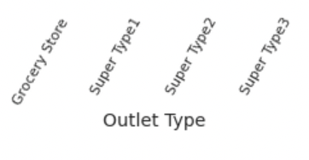
MRP is Affected by Food Item and Outlet Type
Breads and Breakfast items are cheapest at Super Markets of Type 2
Hard Drinks and Seafood are most expensive at Super Markets of Type 2

Slide 5
Recommendation in Predicting MRP of Items
Linear Regression (LR) Models perform better than Simple Decision Tree Regression (DTR) Models on these data as (DTR) Modeling overfits the data

